Slide 1
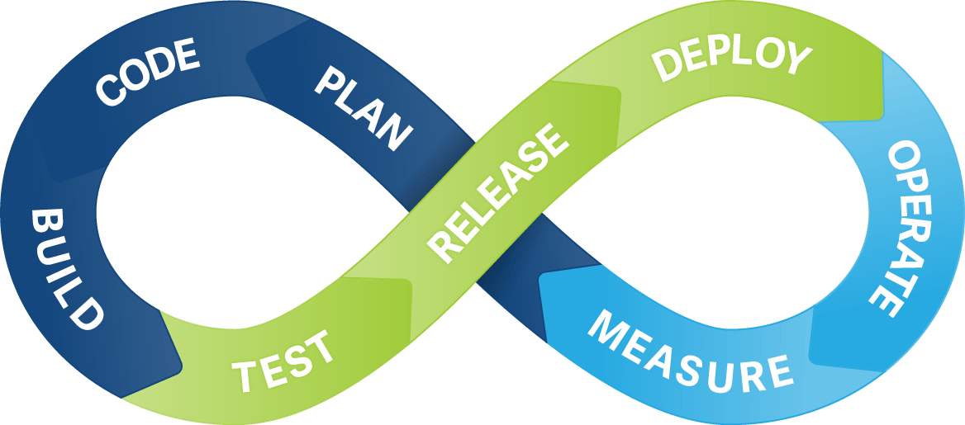
Continuous Integration & Deployment

Slide 2

What is a Continuous Integration?
Continuous Integration (CI) is a development practice that requires developers to integrate code into a shared repository several times a day. Each check-in is then verified by an automated build, allowing teams to detect problems early.
Notes:
Developers practicing continuous integration merge their changes back to the main branch as often as possible. The developer's changes are validated by creating a build and running automated tests against the build. By doing so, you avoid the integration hell that usually happens when people wait for release day to merge their changes into the release branch.

Slide 3
What we neeD
Continuous Integration
What we Gain
Automated tests
Continuous integration server
Merge our changes more often
Less bugs get shipped to production
Building the release is easy
Less context switching
Economy testing costs
Notes:
What we need:
Our team will need to write automated tests for each new feature, improvement or bug fix.
We need a continuous integration server that can monitor the main repository and run the tests automatically for every new commits pushed.
Developers need to merge their changes as often as possible, at least once a day.
What we gain:
Less bugs get shipped to production as regressions are captured early by the automated tests.
Building the release is easy as all integration issues have been solved early.
Less context switching as developers are alerted as soon as they break the build and can work on fixing it before they move to another task.
Testing costs are reduced drastically – your CI server can run hundreds of tests in the matter of seconds.

Slide 4
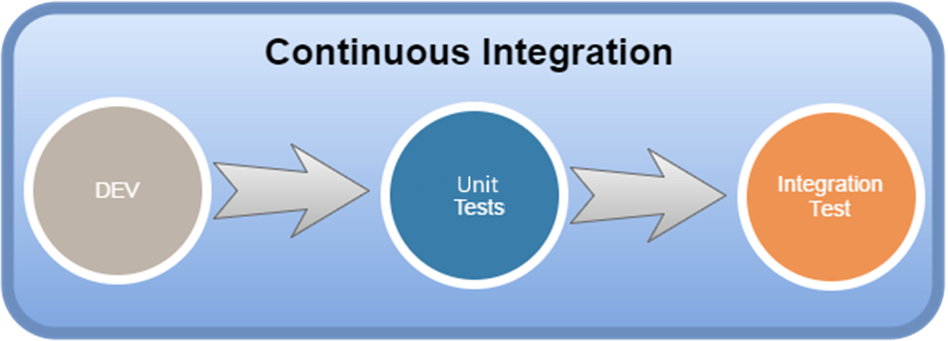
Integration Testing is the phase in software testing in which individual software modules are combined and tested as a group.
Unit Testing is a level of software testing where individual units/ components of a software are tested.
Notes:
The purpose is to validate that each unit of the software performs as designed.
A unit is the smallest testable part of software.

Slide 5
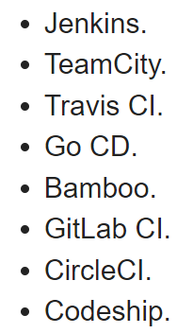








Continuous integration serverS

Slide 6

What is a Continuous Deployment?
Continuous deployment is an extension of continuous integration. With this practice, every change that passes all stages of your production pipeline is released to your customers.
There's no human intervention, and only a failed test will prevent a new change to be deployed to production.
Notes:
“Every change that passes all stages of our production pipeline is released.”
Does it means that changes can be released in parts related to passing test?

Slide 7
What we neeD
Continuous Deployment
What we Gain
High quality tests
Actual documentation
Using flag features (recommended)
Faster development
Releases are less risky
Satisfied customer
Notes:
What we need:
Our testing culture needs to be at its best. The quality of your test suite will determine the quality of your releases.
Our documentation process will need to keep up with the pace of deployments.
Feature flags become an inherent part of the process of releasing significant changes to make sure you can coordinate with other departments (Support, Marketing, PR...).
What we gain:
You can develop faster as there's no need to pause development for releases. Deployments pipelines are triggered automatically for every change.
Releases are less risky and easier to fix in case of problem as you deploy small batches of changes.
Customers see a continuous stream of improvements, and quality increases every day, instead of every month, quarter or year.

Slide 8
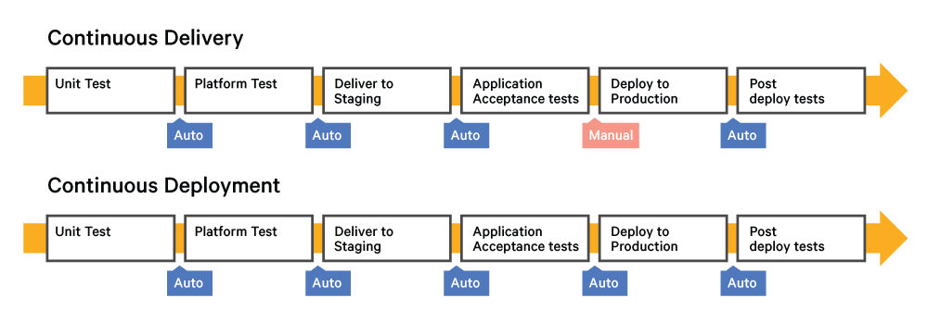
Testing
Continuous Deployment
Continuous Integration
The purpose of this test is to evaluate the system's compliance with the business requirements and assess whether it is acceptable for deployment.
Post deploy tests is needed to
making sure the features released meet the requirements.

Slide 9
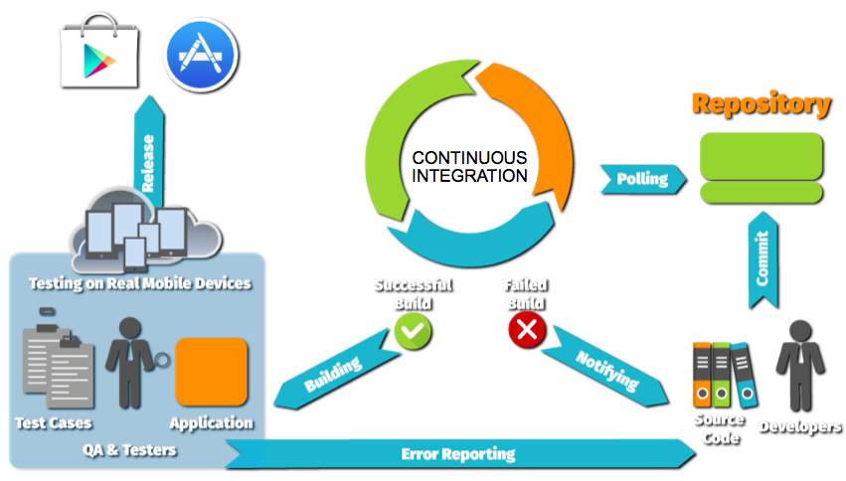
Scheme of work

Slide 10
CD – Continuous Deployment or delivery?
Continuous Integration
Notes:
* + and – just for us
* Continuous Deployment is accelerate Continuous Delivery

Slide 11
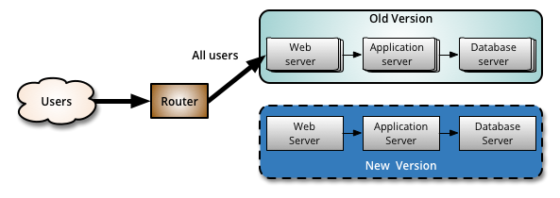
BlueGreenDeployment
For what? To minimize a downtime and the risk of deployment failure.
Problem resolving:
Notes:
One of the challenges with automating deployment is the cut-over itself, taking software from the final stage of testing to live production. You usually need to do this quickly in order to minimize downtime. The blue-green deployment approach does this by ensuring you have two production environments, as identical as possible. At any time one of them, let's say blue for the example, is live. As you prepare a new release of your software you do your final stage of testing in the green environment. Once the software is working in the green environment, you switch the router so that all incoming requests go to the green environment - the blue one is now idle.

Slide 12
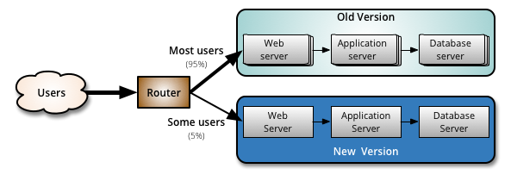
Canary release
For what? To reduce the risk of introducing a new software version in production.
Problem resolving:
Notes:
slowly rolling out the change to a small subset of users before rolling it out to the entire infrastructure and making it available to everybody.

Slide 13

Chaos Monkey
For what? To prevent major unexpected failures.
Where? Amazon Web Services.
Problem resolving: to simulate failures in a real environment and to check that the computer system continues to work.
Notes:
The Simian Army^{[5][6]} (ape army) is a suite of tools developed by Netflix to test the reliability, security, or resiliency of its Amazon Web Services infrastructure. .^{[7]}
Chaos Monkey
The first tool developed by Netflix, it allows random selection of instances in the production environment and deliberately put them out of service.
Gorilla Chaos
At the very top of the Simian Army hierarchy, Chaos Gorilla, drops a full Amazon Availability Zone. ^{[8]}
Latency Monkey
By introducing communication delays at the communication layer level, a tool that allows to test the tolerance to the loss of performance of an external component whose system is dependent upon, up to the simulation of a complete cut - an infinite delay ; without having to ask the partner concerned to cut his service.
Doctor Monkey
Tool that detects all instances that present health risks - CPU overload for example - and separates them from the system for root cause analysis or even extinction.
Janitor Monkey
Tool that disables any unused instances to avoid over-consuming.
Conformity Monkey
Tool that disables any nonconforming instances to allow the system to recreate it properly.
Monkey safety
Derived from the Conformity Monkey , a tool that disables all instances that have vulnerabilities.
10-18 Monkey
Tool that detects problems of localizations, languages (l10n-i18n) on instances.

Slide 14


